Slide 1


Introduction to
Robotic Process Automation
The Automated Festival Countdown and Train Booking Reminder System
Your Register No:220701320
Name: S.T.Vijayetha
Designation and Department: IRPA

Slide 2
Abstract
The Automated Festival Countdown and Train Booking Reminder System Using UiPath is a user-centric project designed to streamline festival planning and train ticket booking management. This system leverages UiPath's automation capabilities to dynamically read festival data from an Excel sheet, including festival names, dates, train booking start and end dates. Users provide a festival name as input, and the system calculates the train booking timeline, days remaining for booking to open, and whether booking is currently open or closed. It displays clear, intuitive outputs such as the festival name, date, booking start and end dates, and the current booking status. The project integrates real-time date calculations to ensure accuracy and user relevance. Additionally, it can be enhanced with features like SMS/email notifications, multi-year data support, and real-time train booking data, making it a scalable solution for festive travel planning. This automation reduces manual effort, enhances user convenience, and ensures no opportunity is missed due to delayed bookings.

Slide 3
Need for the Proposed System
The Automated Festival Countdown and Train Booking Reminder System Using UiPath is a comprehensive automation project designed to help users efficiently manage festival schedules and train ticket bookings. This system reads structured data from an Excel sheet containing festival names, dates, and train booking start and end dates, then processes this data to deliver accurate and real-time updates. Users input the name of a festival, and the system calculates key details such as the remaining days until booking opens, the duration for which bookings are available, and whether the booking period has ended. It then displays the festival name, date, booking start and end dates, and a clear status update (e.g., "Booking Open," "Booking Closed," or "Booking Yet to Start"). The project eliminates the need for manual date tracking, ensuring accuracy and convenience. Scalable and user-friendly, this system can be enhanced with features like multi-year data support, SMS/email notifications for reminders, and real-time integration with train booking systems, making it an indispensable tool for users to stay organized during the festive season and avoid missed opportunities for travel arrangements

Slide 4
Advantages of the Proposed System
Automated Notifications: Sends timely reminders via email and SMS about upcoming festivals and train booking dates, ensuring users don’t miss important events.
Real-Time Data: Provides up-to-date train booking information, helping users secure tickets based on current availability.
Customizable & Dynamic: Allows users to personalize festival lists and ensures the system stays updated with new events and dates
Countdown Feature: Displays a countdown to upcoming festivals or booking dates, helping users stay organized and plan ahead.
User-Friendly Interface: Easy-to-use design with clear visuals for countdowns and notifications, enhancing the overall user experience.

Slide 5
Literature Survey
Paper 1
Advantages
Disadvantages
Paper 2
Advantages
Disadvantages

Slide 6
Main Objective
The main objective of the Automated Festival Countdown and Train Booking Reminder System project is to provide users with timely notifications and reminders for upcoming festivals and train booking dates, ensuring they don't miss important events. The system aims to enhance convenience by automating the process of tracking festivals, calculating countdowns, and providing real-time train booking data. It also allows for customization, supports multiple languages, and can include weather forecasts for better planning, all through an intuitive user interface.

Slide 7
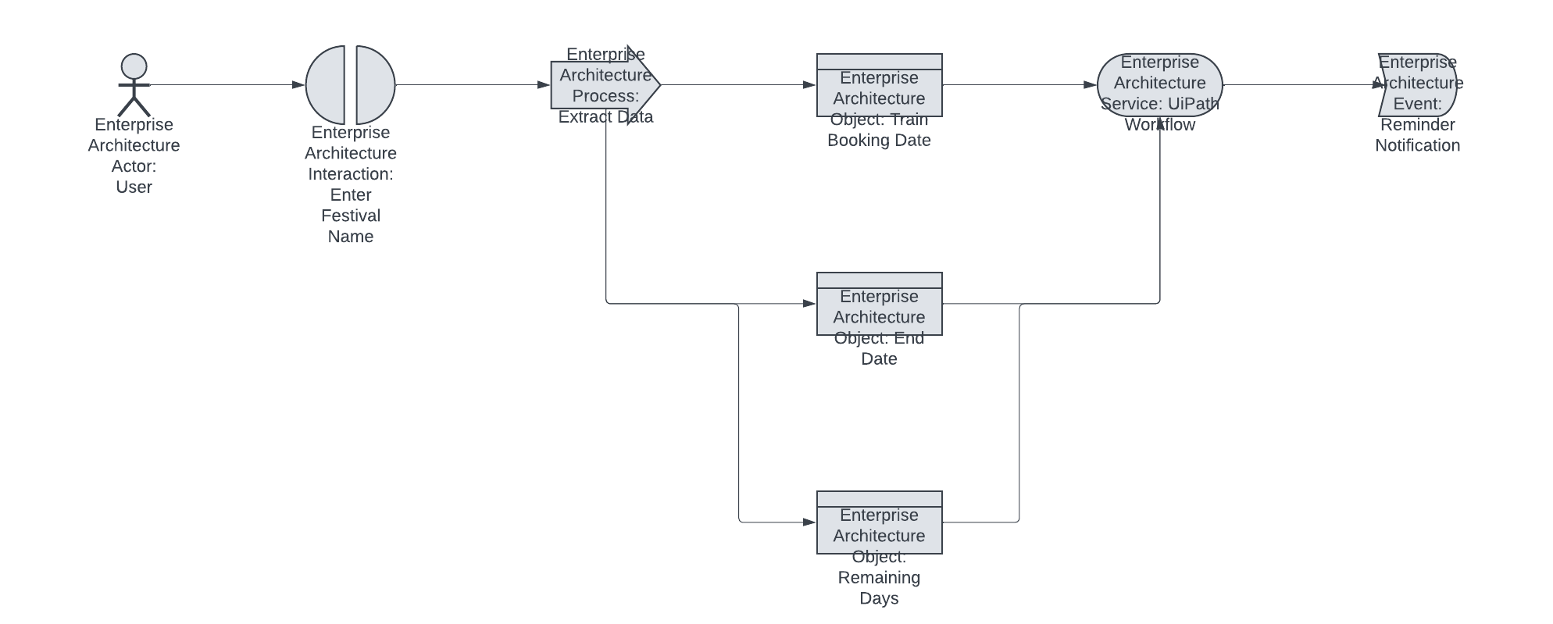
Architecture

Slide 8
System Requirements
Hardware Requirements:
Processor: 2.0 GHz dual-core (recommended 2.5 GHz or higher).
RAM: Minimum 4 GB (recommended 8 GB).
Storage: 500 MB free space (recommended 1 GB).
Display: 1024 x 768 resolution (recommended 1920 x 1080).
Internet: Required for API access and notifications.
Software Requirements:
Operating System: Windows 10 or Windows Server 2016+.
UiPath Studio & Robot: Latest version of UiPath Studio and Robot installed.
UiPath Orchestrator: Optional for scheduling and monitoring workflows.
Database: SQL Server, MySQL, or Excel for storing data.
Notification Services: SMTP or SendGrid for emails, Twilio for SMS.
Web Browser: Chrome or Firefox for scraping and API calls.

Slide 9
Functional Description
Module 1: Festival Countdown and Notification System
Short Description:
This module tracks upcoming festivals and their corresponding countdowns. It notifies users about the approaching festivals and provides real-time updates such as train ticket availability for festival travels. It integrates with email and SMS notification systems.
DFD/Activity Diagram:
DFD:
  Level 1:
    Input: Excel file with festival data.
    Process: Calculate countdown to each festival.
    Output: Countdown data displayed to users via a user interface.
    Notification System: Sends alerts about festivals (via Email/SMS).
  Level 2:
    Festival Data Handler: Reads and updates festival data.
    Countdown Logic: Calculates and updates the festival countdowns.
    Notification Service: Sends out email and SMS notifications based on defined thresholds (e.g., "3 days to go").
Activity Diagram:
  User Inputs Festival Data.
  System Reads Excel Data.
  System Calculates Countdown.
  Countdown is Displayed.
  Check for upcoming festivals.
  Notification sent if the festival is near.

Slide 10
Functional Description
Module 2: Train Booking for Festivals
Short Description:
This module allows users to book train tickets for their desired festival travel dates. It integrates with train booking systems to check for real-time availability and helps in managing travel bookings, including notifications for successful bookings.
DFD/Activity Diagram:
DFD:
  Level 1:
    Input: User selects a festival date for train booking.
    Process: Check real-time availability for trains.
    Output: Display train booking options to the user.
    User makes a booking and receives a confirmation notification.
  Level 2:
    Booking Data Handler: Fetches available trains for the selected date.
    Availability Checker: Verifies available train tickets.
    Booking Confirmation: Confirms the booking and sends out an email/SMS notification to the user.
Activity Diagram:
  User selects festival and travel date.
  System checks for available trains.
  User selects train.
  Booking request is processed.
  System confirms booking and sends confirmation notification.

Slide 11
Process Design
1. Main Process Design
The main process outlines the primary steps or stages required to complete the overall task or system.
Example: UiPath Festival Countdown System
Main Process: Festival Countdown & Ticket Booking System
Step 1: Initialize Festival Data
  Input: Load festival data from an Excel sheet or external source.
  Action: Read the festival names, dates, and other information.
  Output: List of festivals with details.
Step 2: Calculate Countdown for Each Festival
  Input: Current date, festival dates.
  Action: For each festival, calculate the number of days remaining.
  Output: Countdown value for each festival.

Slide 12
Step 3: Display Festival Information and Countdown
  Input: Festival details and countdown values.
  Action: Show this information on a user interface (UI), like a web or desktop application.
  Output: Display list of festivals with corresponding countdowns.
Step 4: Train Booking Date Calculation
  Input: Festival date.
  Action: Calculate the ideal train ticket booking date based on the festival's date.
  Output: Display the booking date for each festival.
Step 5: Send Notifications (Email/SMS)
  Input: User preferences for notification (email, SMS).
  Action: Trigger email or SMS notification to users about the upcoming festival and ticket booking date.
  Output: User notifications sent.
Step 6: Handle Dynamic Updates
  Input: User interaction, new festivals, or updated information.
  Action: Dynamically update the festival list, countdowns, and notifications.
  Output: Updated festival and countdown information.

Slide 13
Process Design
2. Sub-processes Design
Sub-processes are smaller tasks or steps that support the main process. These could be part of a larger automation process.
Sub-process 1: Load Festival Data
  Input: Excel file or API for festival data.
  Action: Extract festival details from the data source (e.g., festival names, dates).
  Output: A structured list or table with festival data.
Sub-process 2: Calculate Countdown for Festival
  Input: Current date, festival date.
  Action: Use date calculation logic (e.g., days = festival_date - current_date).
  Output: Number of days remaining for each festival.
Sub-process 3: Calculate Train Ticket Booking Date
  Input: Festival date.
  Action: Calculate optimal booking window (e.g., 30 days before the festival).
  Output: Suggested train booking dat

Slide 14
Sub-process 4: Send Notifications
  Input: User information (email/SMS).
  Action: Trigger email/SMS using services (e.g., SMTP for email, Twilio for SMS).
  Output: Confirmation of successful notification.
Process Flow Example:
Main Process starts with initializing data.
Sub-process 1 is triggered to load the festival data.
Sub-process 2 calculates the countdown for each festival.
Main process continues to calculate the train booking date using Sub-process 3.
Sub-process 4 sends notifications to the users.
Main process handles dynamic updates as necessary.

Slide 15
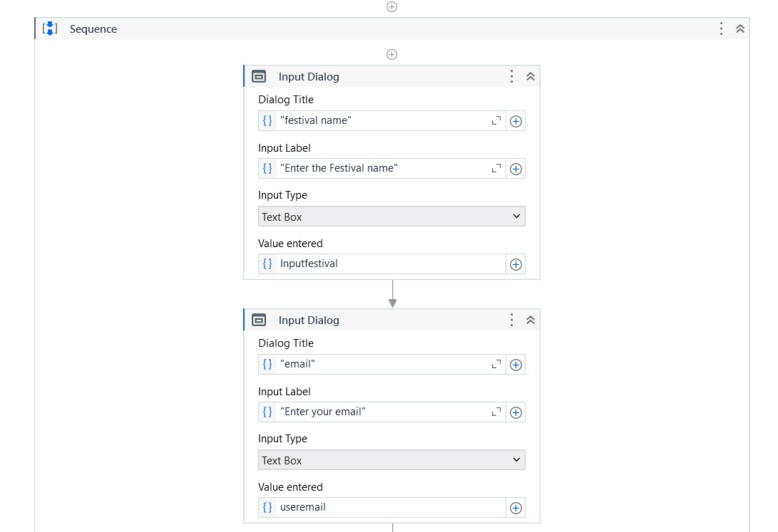
Implementation

Slide 16
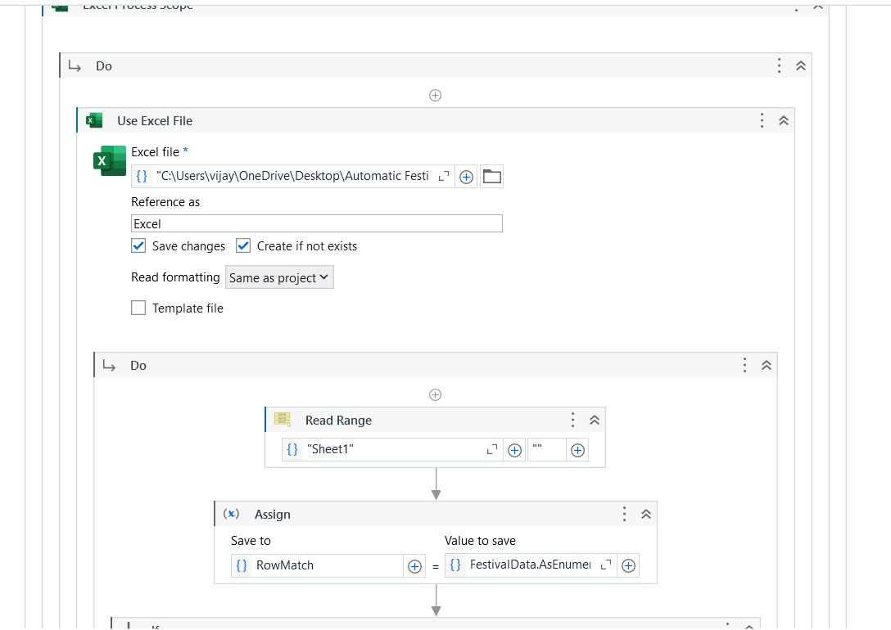

Slide 17
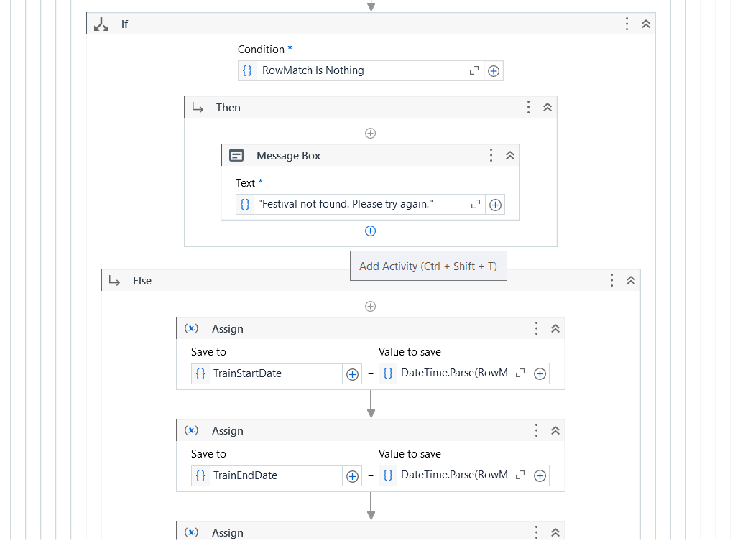

Slide 18
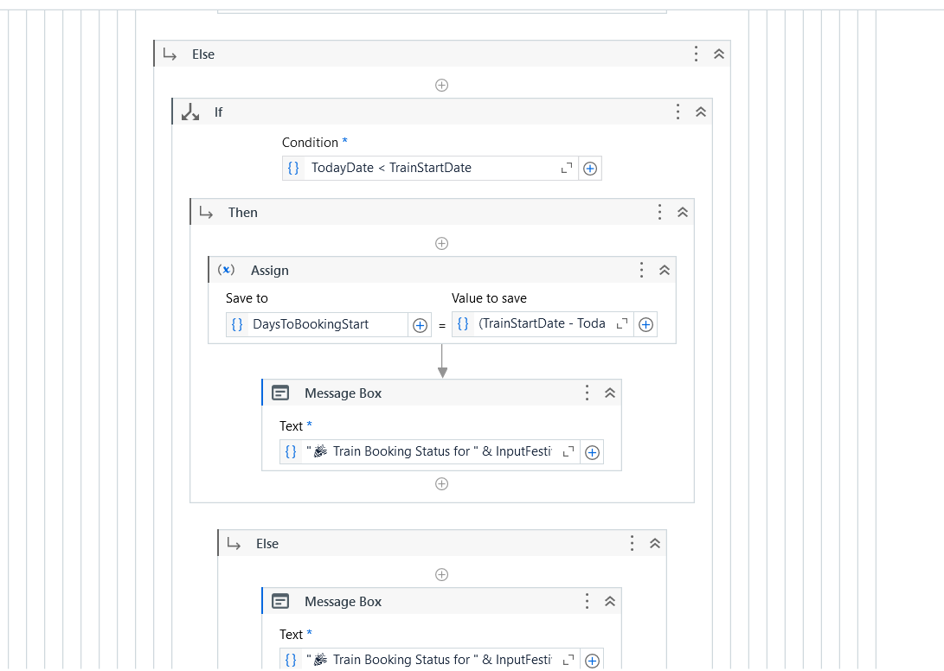

Slide 19
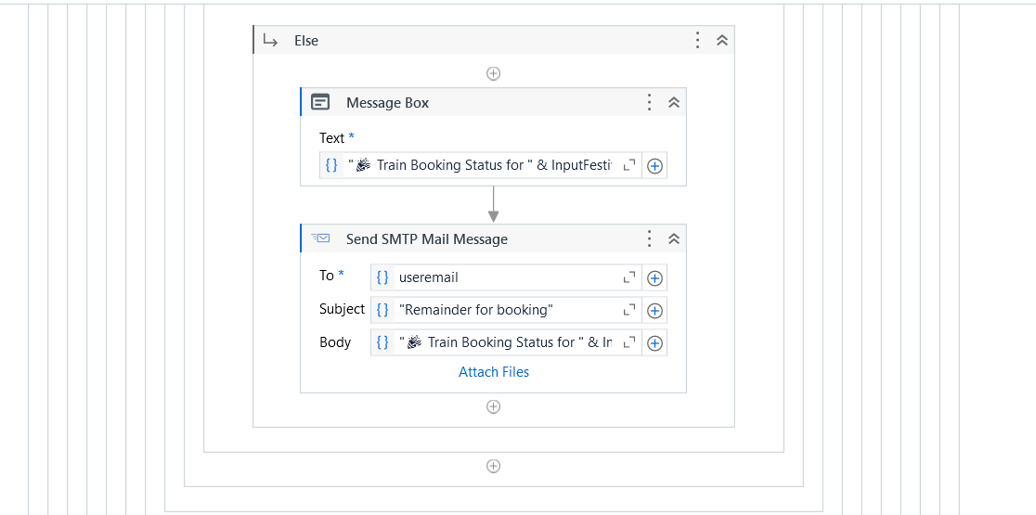

Slide 20
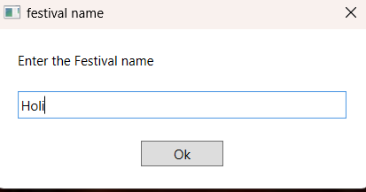
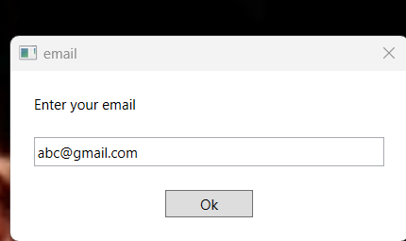
Testing

Slide 21
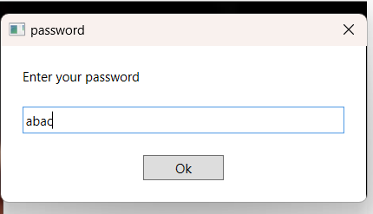
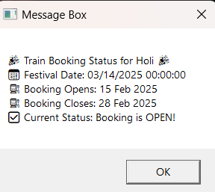

Slide 22
Conclusions
The Automated Festival Countdown and Train Booking Reminder System brings convenience and joy to users by effortlessly managing festival dates and travel bookings. With its intuitive design, real-time notifications, and seamless integration of festival countdowns and train schedules, the system ensures users never miss an important moment. By offering personalized reminders via email and SMS, this smart solution transforms how people plan and prepare for festivals and journeys. Powered by UiPath’s automation, the system is not only efficient but also elegant, providing a delightful and stress-free experience for users seeking to stay organized and ahead of the curve

Slide 23
Future Enhancement
Description 1
In the future, the Automated Festival Countdown and Train Booking Reminder System can be enhanced by integrating advanced AI and machine learning algorithms to provide personalized travel recommendations based on user preferences and past behavior. The system could also incorporate predictive analytics to suggest optimal travel times and routes during peak festival seasons, helping users avoid overcrowded trains and book tickets in advance. Additionally, incorporating voice-based assistants (like Google Assistant or Alexa) would allow users to receive reminders and updates through simple voice commands, making the system even more accessible and user-friendly.
Description 2
Another exciting enhancement would be the integration of smart weather forecasting to provide real-time weather updates for upcoming festivals, particularly for outdoor events. This feature could help users plan better by suggesting the right clothing or equipment. Furthermore, expanding the system’s capabilities to include multi-platform support—such as mobile apps for both Android and iOS—would allow users to stay connected and receive notifications on the go. With further integration of social media platforms, users could share festival plans or train bookings with friends, making the system a one-stop solution for festival and travel planning.

Slide 24
IEEE Paper
Title "Petri net modeling of information flow in the online train ticket booking system,"
Authors C. Song and W. Wu, "Petri net modeling of information flow in the online train ticket booking system," 2012 IEEE International Conference on Automation and Logistics, Zhengzhou, China, 2012, pp. 517-522, doi: 10.1109/ICAL.2012.6308258
keywords: {Software;Mathematical model;Petri nets;Analytical models;Electronic mail;Computer crashes;Computers;Online Train Ticket Booking System;Information Flow;Petri Net;Modeling}

Slide 25
References
1. The Petri net language: Concept, technology, and tools
2. An algorithm for the general Petri net reachability problem
3. Real-time deadlock-free scheduling for semiconductor track systems based on colored timed Petri nets
4. Safety analysis using Petri nets
5. A Petri net technique for process planning cost estimation
6. A generic petri net model for dynamic process planning and sequence optimization
7. Timed Petri net simulation capability
8. Using state equation to prove non-reachability in timed Petri nets
9. Manufacturing system optimization based on Petri net
10. Petri nets: Properties, analysis and applications

Slide 26
Thank You

